Slide 1
Recovering Energy from Waste Otaki Transfer Station
Findings of Feasibility Study
Project Funded by Kapiti Coast District Council
Waste Minimisation Levy

Slide 2
What will cover
Concept
Technical Aspects and Findings
Economic Feasibility
Environmental Implications
Conclusions

Slide 3
Concept for Testing
technical and economic viability of an integrated waste to energy system using the following waste streams:
plastics and used tyres - via pyrolysis
food waste generated in Otaki (via gasification). This may also include other biomass.
biosolids from the Otaki Wastewater Treatment Plant – via pyrolysis
A long-term solution to avoid transport and landfilling of biosolids
Test an energy management and battery storage system
supply recovered energy to the on-site processes,
supply optimised surplus energy to the electricity grid,
export the chars and liquid fuels from pyrolysis.
Explore the economic viability deployment of potential thermal energy generated from waste to the adjacent industrial area for use by businesses.
To develop a financial model for Otaki

Slide 4
Original Concept: Regen - Integrated Waste to Energy Concept
Solar Array
Foodwaste (Other Biomass)
Bio gas production
Surplus Gas for on-use
WWTP Biosolids
Drier
Pyrolyser
Generator
Energy Management and Storage
Surplus Electricity Direct Use or Grid
Plastics and waste tyres
Pyrolyser
Sale of Usable Carbon and Surplus Liquid Fuels
Surplus thermal heat for on-use

Slide 5
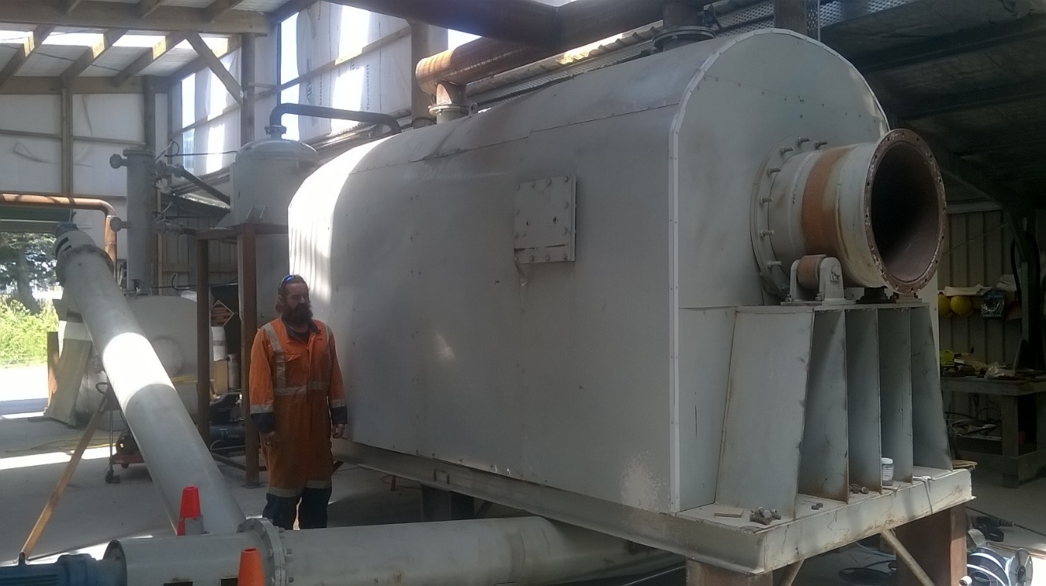
Technologies – Pyrolysis
Heating of hydrocarbons to point of gasification
Condensed gases separate into non-condensable gases, liquids (crude oils) and solid fuel (char) as they cool.
NOT INCINERATION
2.8m3 retort – approx. 1 tonne of waste material
All outputs can be used for heating
Gas and liquid fuels (with some modification) can be used to produce electricity

Slide 6
Technologies – Anaerobic digestion
Well proven technology
Modular – sized here for Otaki using an English system
Assumed using the gas for heating the pyrolysis system rather than sold on
With treatment can remove CO2

Slide 7
Technologies - Combined Heat and Power Generators
system uses fuel to drive a generator
captures the normally wasted heat for use as hot water or hot air
using relatively unrefined fuels from pyrolysis so modelled a less demanding ECE.
Stirling cycle systems are becoming available with a combined efficiency of around 70%.
based our calculations on an Austrian system with that level of efficiency

Slide 8
Feedstocks
Table 1: Available and Usable Waste Streams
Waste Type | Total Weekly Otaki (t) | Currently Usable Weekly Otaki (t) | Further Usable Feedstocks all KCDC (t) | Assumed Total Available Feedstocks (t) |  | % of Total Waste Stream
 |  |  |  | pw | pd
Biosolids (20% w/w) | 1.3 | 1.3 | 5.4 | 6.7 | 0.96 | 100%*
Tyres | 1.0 | 1.0 | 4.0 | 5.0 | 0.7 | 100%*
Plastics | 12.8 | 11.6 | - | 11.6 | 1.7 | 91%**
Food waste | 28.0 | 3.3 | - | 7.0 | 1.0 | 25%**

Slide 9
Table 2: Daily, Weekly and Annual Cook Volumes
Waste Type | Feedstocks per cook (t) | Weekly amounts processed (t) | Annual amounts processed (t)*
Biosolids (20% w/w) | 0.96 | 6.7 | 315
Tyres | 1.0 | 7.0 | 329
Plastics | 0.1 | 0.7 | 33
Food waste | 1.0 | 7.0 | 329
Total |  |  | 1006

Slide 10
Calculating the Energy Balance
This means assessing:
the gross energy produced by the process;
the energy required to drive it, including additional drying of the biosolids, and
any waste energy recovered from the process i.e. waste heat from the pyrolysis flue.
remaining energy for further use

Slide 11
Net Expected Energy Yields from Pyrolysis Process
Input Waste Stream | Tonnes per Cook | Gross Energy Output (GJ) | Net Energy Output (GJ)
Dried Biosolids | 0.96 | 18.1 | 14.6
Tyres | 0.7 | 16.8 | 14.7
Plastics | 0.1 | 2.7 | 2.5
Total Pyrolysis | 1.76 | 37.6 | 31.8
Net Expected Energy Yield from Anaerobic Digestion
Food waste | 1 | 4.6 | 4.1

Slide 12
Scale
In summary:
each pyrolysis cook will produce a net benefit of 31.8 GJ.
Over a year at seven days per week, 10,446 GJ of energy assuming 90% operating time.
This is equivalent to the annual energy consumption of ~410 households. Source: NZ Energy Authority

Slide 13
Table 5: Energy type produced by each feedstock
Type of Energy Produced | Energy Produced (GJ pd) | Net Available Energy (GJ pd) | Comment
Gas |  |  | All pyrolysis gas is used to power the pyrolysis process. 10% of anaerobic digestion gas is used in the process.
- pyrolysis | 6.2 | -
- anaerobic digestion | 4.6 | 4.1
Liquid Crude Oil | 18.2 | 17.0 | A small amount is used to power the pyrolysis process and the remainder is available for other downstream uses.
Char | 13.2 | 13.2 | All available for downstream use.
Recovered heat | 1.6 | 1.6 | All available for downstream use.
Total | 43.8 | 35.9

Slide 14
Economic Feasibility
Two revenue streams
Payment for processing of waste – assumed paid at current cost of landfilling and transportation
Sale of end use energy
(assumed current electricity price per megawatt)
Direct sale of unrefined energy
Direct sale of refined energy
Conversion to electricity with or without storage against peak loads –local behind the meter or grid
Conversion to hot water and hot air for industrial use
Models
Commercial return
Community return – no cost of capital

Slide 15
Economic Feasibility
Direct sale of remaining energy in raw form for sale
gas cannot be used as a substitute in Natural Gas equipment unless refined
liquid fuels – limited use ( NZ burners requires splitting into two fractions)
solid/ char - could be used as a solid fuel extender
Recovered heat – small amounts not viable
Refinement of gas and liquid fuels for sale
Anaerobic gases can be refined to take out CO2 and can compress – volumes too small
Liquid fuel can be refined to a kerosene type and petrol like fraction – volumes too small
Solid/ chars – can remove all hydrocarbons - uses beyond a fuel worthy of further exploration

Slide 16
Economic Feasibility
Four Scenarios
Conversion to electricity
Attractive because easy to use and market
Conversion efficiencies at the scale of energy available make it marginal
Conversion to hot water and hot air for industrial use
Can use available fuels to convert
81 tonnes of hot water per day
Most viable option

Slide 17
Food waste
Bio gas production
Gas
Hot water/ heat production
Liquid Fuel
Drying to 20%
Pyrolysis
WWTP Biosolids
Recovered Heat
Plastics and waste tyres
Char
Direct sale.

Slide 18
Table 7.2 Returns Community Model $000 p.a. $100 per MW
 | Hot water/air | Electricity
Commercial | 20 | -92
Community | 209 | 117
No change in landfill charges
Can also increase throughput – at 150% commercially viable – caution
Certain market –eg use of chars as substitute for wood pellets – ghg emissions
Table 7.4 Returns Community Model $000 p.a. $150 per MW
 | Hot water/air | Electricity
Commercial | 107 | - 10
Community | 297 | 199

Slide 19
Environmental Considerations
Table 8: Comparison of Greenhouse Gas Emissions by Energy Type
Comparator Fuel | kg CO₂-e /GJ | Otaki Waste to Energy Fuel | Composition: % biofuel | kg CO₂-e /GJ
Coal/lignite | ~100 | Pyrolysis Char | ~ 72% | ~30
Diesel/gasoline | ~ 72 | Pyrolysis Liquid | ~ 58% | ~30
LPG/CH₄ | ~ 60 | Anaerobic Gas | ~ 79% | ~ 13
NZ electricity | ~ 38
https://www.volker-quaschning.de/datserv/CO2-spez/index_e.php;
https://www.eecabusiness.govt.nz/tools/wood-energy-calculators/co2-emission-calculator/ accessed 17 April 2020.

Slide 20
Environmental Considerations
Table 9: Annual GHG reduction from use of Otaki fuels (t CO₂-e)
Comparator Fuel | GJ pd replaced (Table 5) | Fossil fuel GHG kg CO2-e pd | Otaki fuel GHG kg CO2-e pd | Emissions reduction kg CO₂-e
Coal/lignite | 13 | 1,300 | 390 | ~30
Diesel/gasoline | 17 | 1,224 | 367 | ~30
LPG/CH₄ | 4 | 240 | 31 | ~ 13
Total pd kg |  | 2,764 | 788 | 1,976
Total pa tonnes* |  | 908 | 259 | 649 (64 tonnes)

Slide 21
Environmental Considerations
will generate non-GHG emissions to air
Will be similar to use of equivalent fossil fuels in the case of the gaseous and liquid fuels.
tyre char that will be high in sulphur and potentially zinc.
will be within the current limits for discharges to air outside special air quality zones
< 50% of those from high sulphur coal.
low cost ways to improve emissions because the discharges are small point source,
if used as a solid fuel extender will need to be used in plant that has filters.
removal of all hydro carbons for use as a bio-char.

Slide 22
Conclusions
Viable commercially at present if focus on hot water/ air
Viable for community investment
Economics likely to improve as landfill prices increase
May be a point where viable to convert energy to electricity (pricing, end of line economics)
Potential to grow anaerobic processes
challenge of separating at source
need end use markets in Otaki
Transition technology in terms of GHG emissions
One system reduces current emissions by 64 Tonnes per year
Avoids approx. 1000 tonnes to landfill annually from Kapiti Coast

